Slide 1
Introduction
Retail Data Analytics is important process of analyzing data to make important decisions which help to improve the sales, customer satisfaction, quality.
Benefits of Retail data analytics
Customer Satisfaction
Customer Retention
The Owner of Shop should study the behavior of customers buying pattern. In that way we can advertise and improve the needs for better sales and customer service.
I am focused on predicting the Sales of shop and departments Sales in future based on the forecasting and performance of sales.
Built the model to identify any Anomalies in the sales

Slide 2

Business Understanding: Defining the Problem
The main goal of the project is to build a predictive model to predict or determine the sales of the shops and Department and then share the recommendation to improve Sales. Also, to identify the correlation between sales and Department, temperature, Holidays, and other parameters
Also Build the Model to identify the Anomalies in the Sales events

Slide 3
Data Understanding
Pandas library used to load the data from csv to Dataframe
Seaborn and matplotlib are used for data visualization
Data used in this project are online retail dataset collected from Kaggle

Slide 4

Data Understanding
Features Dataset
Contains additional data related to the store, department, and regional activity for the given dates.
Store Dataset
Sales Dataset
Historical sales data - Feb 2010 to May 2011
Store - the store number
Dept - the department number
Date - the week
Weekly_Sales - sales for the given department in the given store
IsHoliday - whether the week is a special holiday week

Slide 5
Data Preparation
Described the dataset and Metadata
Cleaned the data for modelling
Merge Datasets based on the store id

Slide 6
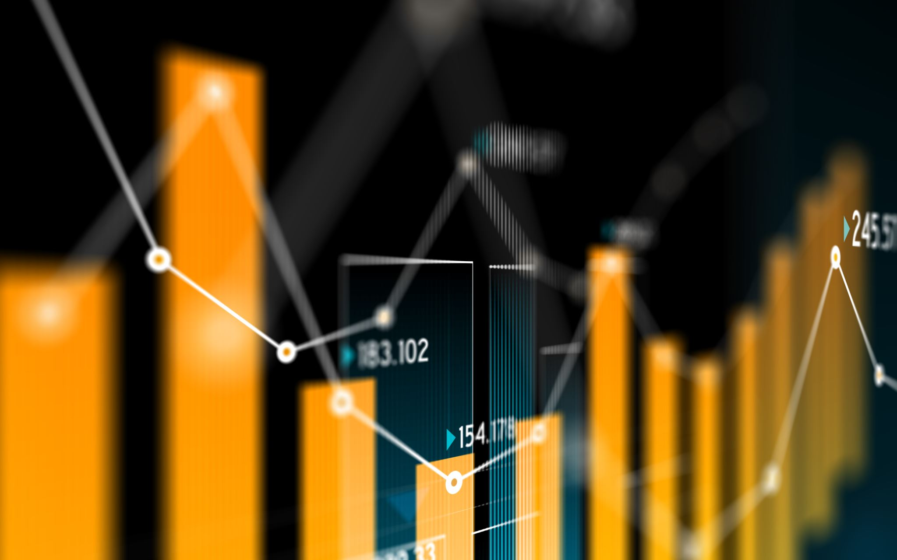
Exploratory Data Analysis
Filling missing information
Encoding of categorical variables
Dropping of features

Slide 7
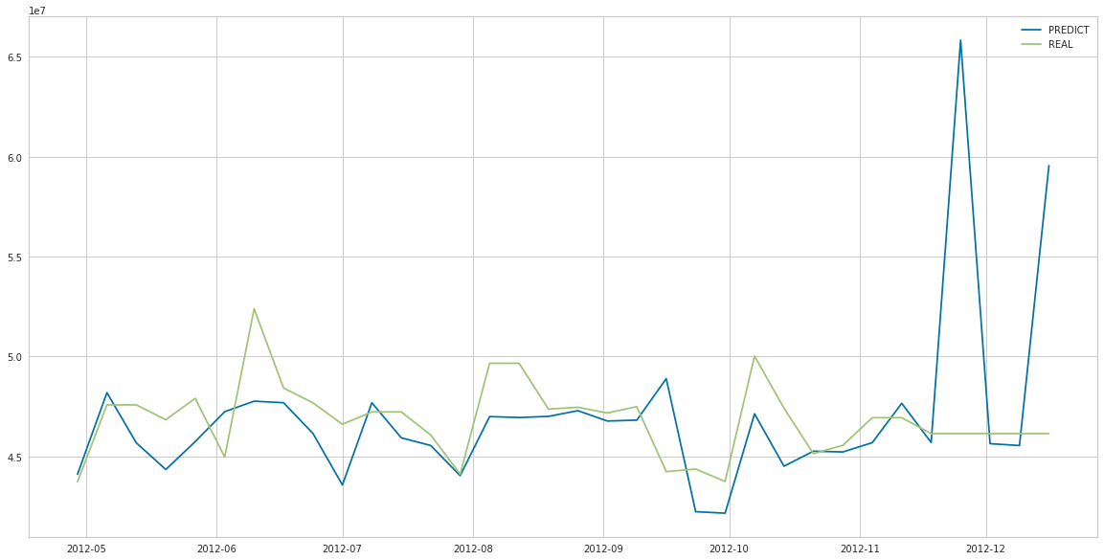
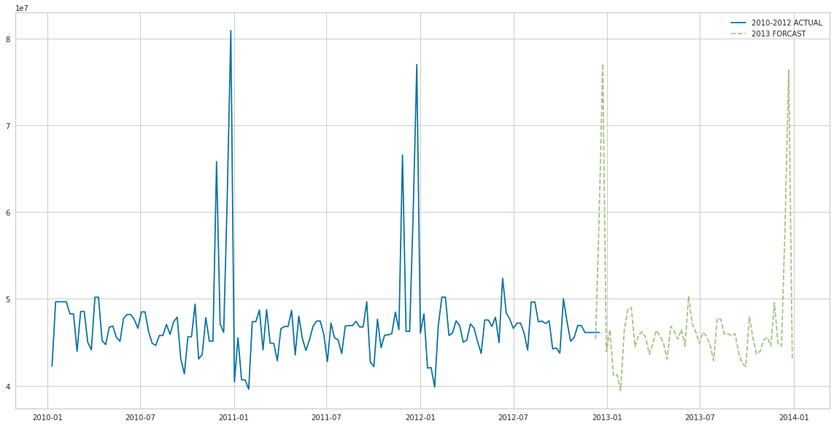
Model Development

Slide 8
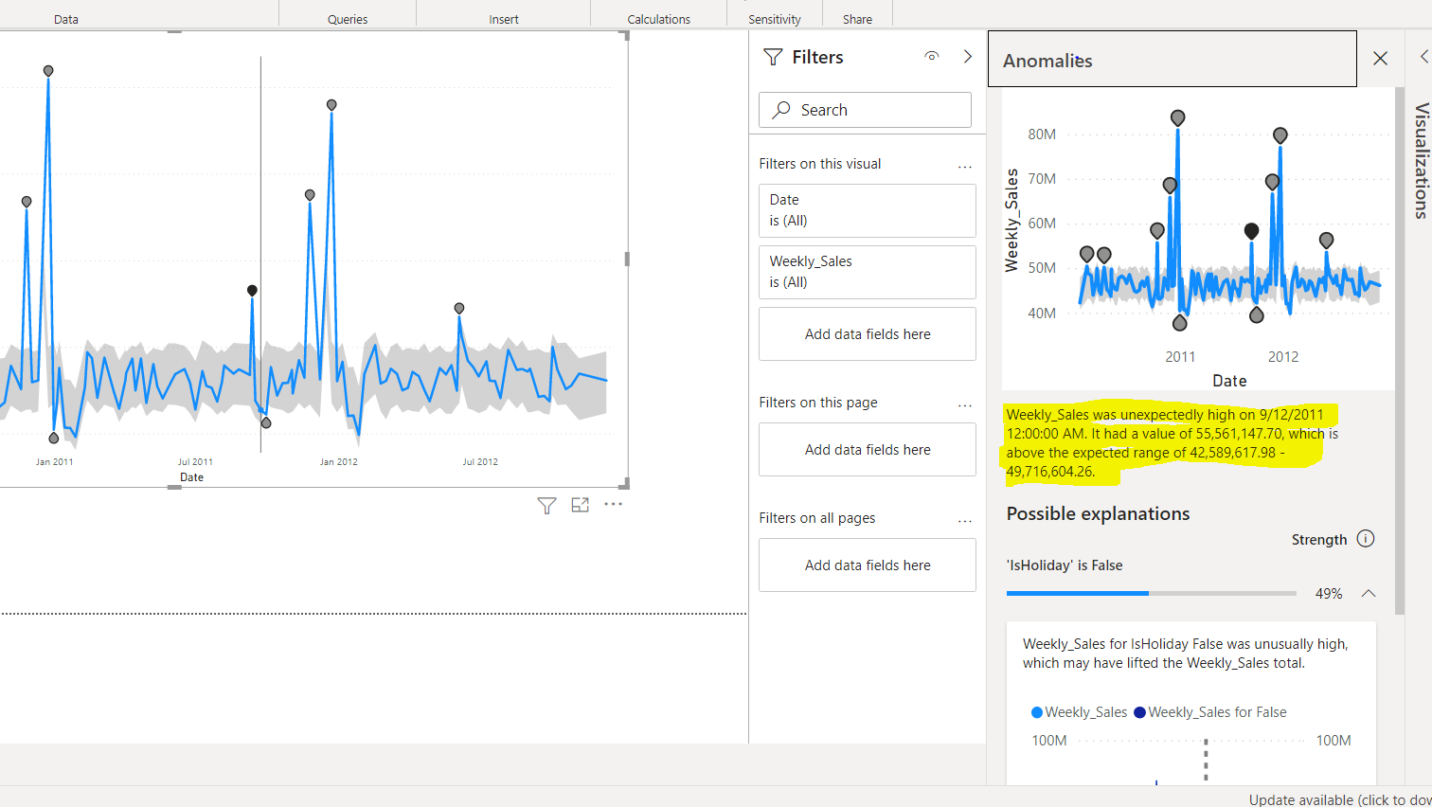
Anomalies

Slide 9

Next Steps

Slide 10
What are your recommendations?
This predictive system is built for Weekly Sales by considering the Holiday, and we can expand this approach to deal with other parameters like Temperature, Inventory, etc. Also, we can expend the data collection by using Product API data or many social media sites application programming interfaces (API) data

Slide 11
Customer Engagement
For Customer long term relationship, we need to win the trust of the customers

Slide 12
References
Predictive Analytics: The Power to Predict Who Will Click, Buy, Lie, or Die by Eric Siegel
Page number – 166 and 167
Applied Predictive Analytics by Dean Abbott (Principles and Techniques for the Professional Data Analyst)
https://www.stitchdata.com/resources/retail-data-analytics/#:~:text=Retail%20data%20analytics%20is%20the,are%20targets%20for%20data%20analytics.
https://www.kaggle.com/manjeetsingh/retaildataset
https://www.kaggle.com/sundarraghavan/demand-forecasting
https://www.forbes.com/sites/gilpress/2016/03/23/data-preparation-most-time-consuming-least-enjoyable-data-science-task-survey-says/?sh=1ffbe4896f63

